Slide 1
G.K.BHARAD INSTITUTE OF ENGINEERING Subject : Element Of Mechanical Engineering Subject Code : 2110006 Topic name : I.C.Engine Group :03
Department : Mechanical 1st - A
Bhalodiya Vivek J. (45)
Shekhada Kishan M. (31)
Bhalara Vishal K. (33)
Ramoliya Ankit D. (25)
Sanghani Anand R. (42)
Guided by - V.M. Ramoliya

Slide 2
INTRODUCTION
An internal combustion engine is a heat engine in which combustion takes place within the engine it self.
Heat engine use a heat source for supply of energy and convert to thermal energy into mechanical energy. (i.e. work)
The heat energy is obtained from the chemical energy of various types of fuels. If the fuel is blast inside the engine. The engine is called internal combustion engine.

Slide 3
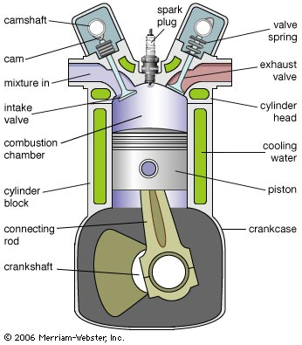
COMPONENTS OF AN I.C.ENGINE

Slide 4
FOUR STROKE ENGINE
The petrol engine work on the principle of theoretical Otto cycle, also known as constant volume cycle.
The piston performs four strokes to complete one working cycle. The four different strokes are
Suction stroke
Compression stroke
Power stroke
Exhaust stroke

Slide 5
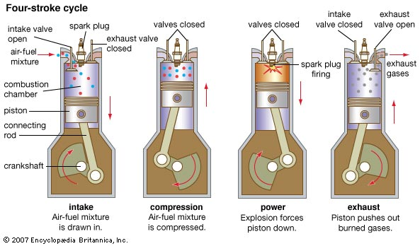
FOUR STROKE CYCLE

Slide 6
WORKING OF FOUR STROKES
Suction stroke :
During this stroke, inlet valve opens and exhaust valve is closed, the pressure in the cylinder will be atmospheric. As the piston moves from TDC to BDC , the volume in the cylinder increases, while the pressure decreases.
Compression stroke :
During this stroke both the inlet valve and exhaust valve are closed, the piston moves from BDC to TDC. As this stroke is being performed, the petrol and air mixture contained in the cylinder will be compressed , so pressure and temperature of mixture increases.

Slide 7
WORKING OF FOUR STROKES
Power or Expansion stroke :
During this stroke both the inlet valve and exhaust valve are closed, the piston moves from TDC to BDC. This stroke is also known as expansion or working stroke. The engine produces mechanical work or power during this stroke.
Exhaust stroke :
During this stroke, the exhaust valve opens and valve is closed. The piston moves from BDC to TDC and during this motion piston pushes the exhaust gases out of the cylinder at constant pressure

Slide 8
FOUR STROKE ENGINE

Slide 9
TWO STROKES ENGINE
All the processes in two stroke cycle engine are completed in two stroke.
In four stroke engine two complete revolutions of crank shaft is required for completing one cycle.
The cycle of operations, i.e. suction, compression, expansion and exhaust are completed in one complete revolution of the crank shaft in two stroke engine.

Slide 10
WORKING OF TWO STROKE ENGINE
First stroke :
At the beginning of the first stroke the piston is at TDC. Piston moves from TDC to BDC. The electric spark ignites the compressed charge. The combustion of the charge will release the hot gases which increases the pressure and temperature in the cylinder.
The high pressure combustion gases force the piston downwards. The piston performs the power stroke till it uncovers the exhaust port.

Slide 11
WORKING OF TWO STROKE ENGINE
Second stroke :
in this stroke the piston moves from BDC to TDC. When it covers the transfer port. The supply of charge is stop and then when it moves further up it covers the exhaust port completely.
Further upward motion of the piston will compress the charge in the cylinder. After the piston riches TDC the first stroke repeats again.

Slide 12
USES OF I.C.ENGINE
I.C.Engines are widely used in road vehicles, locomotives, marine applications and in prime movers for industrial application.
They are more efficient than external combustion engines. Require less space. Are easy to operate and give higher power output per kilogram weight.
They have more or less replaced steam engines in more applications.

